Slide 1
6. Inequalities and limit theorems

Slide 2
Content
1. Inequalities
2. Central limit theorem
3. Monte Carlo Simulations

Slide 3
introduction
What should I do if I can’t calculate a probability or expectation exactly?
Three are powerful strategies:
1. Bounds using inequalities
A bound on a probability gives a provable guarantee that the
probability is in a certain range.
2. Approximations using limit theorems
the law of large numbers and the central limit theorem
3. Simulations using Monte Carlo
Monte Carlo simulation is an extremely powerful technique, and
there are many problems where it is the only reasonable approach
currently available.

Slide 4
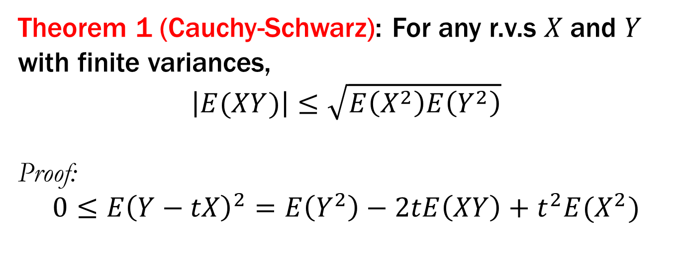
1 Inequalities
Theorem 1 (Cauchy-Schwarz): For any r.v.s $X$and $Y$ with finite variances,
$\left|E(XY)\right|≤\sqrt{E\left(X^{2}\right)E\left(Y^{2}\right)}$
Proof:
$$0≤E{\left(Y−tX\right)}^{2}=E\left(Y^{2}\right)−2tE\left(XY\right)+t^{2}E(X^{2})$$

Slide 5
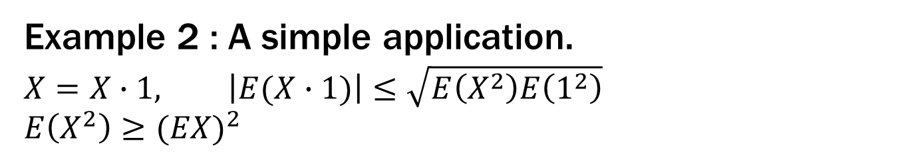
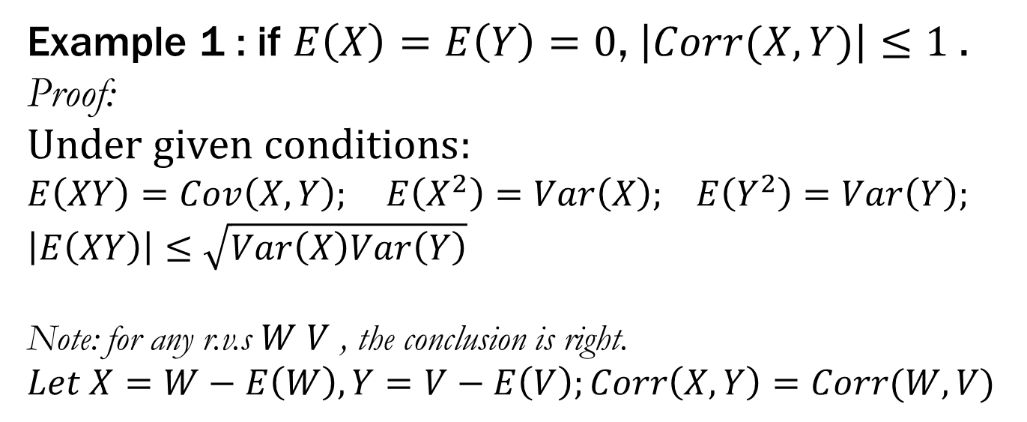
1 Inequalities
Example 1 : if $E\left(X\right)=E\left(Y\right)=0$, $\left|Corr(X,Y)\right|≤1$.
Proof:
$$Under given conditions:$$
$E\left(XY\right)=Cov\left(X,Y\right); E\left(X^{2}\right)=Var\left(X\right);$ $E\left(Y^{2}\right)=Var\left(Y\right);$
$$\left|E\left(XY\right)\right|≤\sqrt{Var\left(X\right)Var\left(Y\right)}$$
Note: for any r.v.s $W V$ , the conclusion is right.
$$Let X=W−E\left(W\right),Y=V−E\left(V\right);Corr\left(X,Y\right)=Corr(W,V)$$
Example 2 : A simple application.
$$X=X∙1, \left|E(X∙1)\right|≤\sqrt{E\left(X^{2}\right)E\left(1^{2}\right)}$$
$$E\left(X^{2}\right)≥{(EX)}^{2}$$

Slide 6
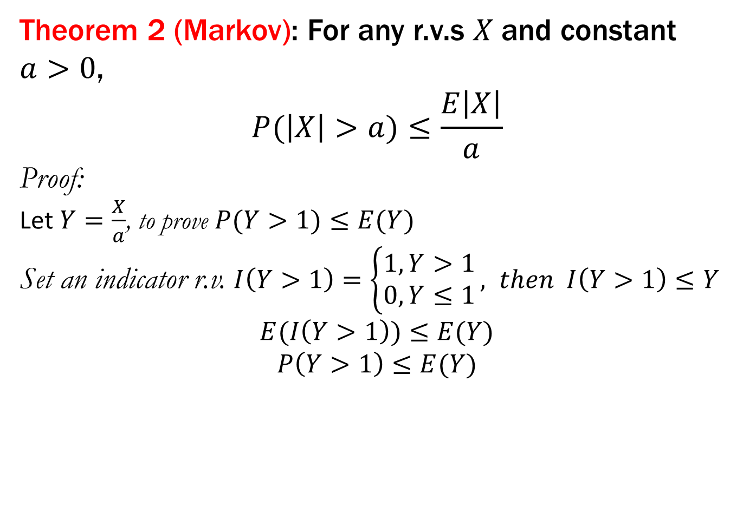
1 Inequalities
Theorem 2 (Markov): For any r.v.s $X$and constant $a>0$,
$$P(\left|X\right|>a)≤\frac{E\left|X\right|}{a}$$
Proof:
Let $Y=\frac{X}{a}$, to prove $P(Y>1)≤E(Y)$
Set an indicator r.v. $I\left(Y>1\right)=\left\{\begin{matrix}1, Y>1 \\ 0, Y≤1\end{matrix}\right., then I\left(Y>1\right)≤Y$
$$E(I\left(Y>1\right))≤E(Y)$$
$$P\left(Y>1\right)≤E(Y)$$

Slide 7
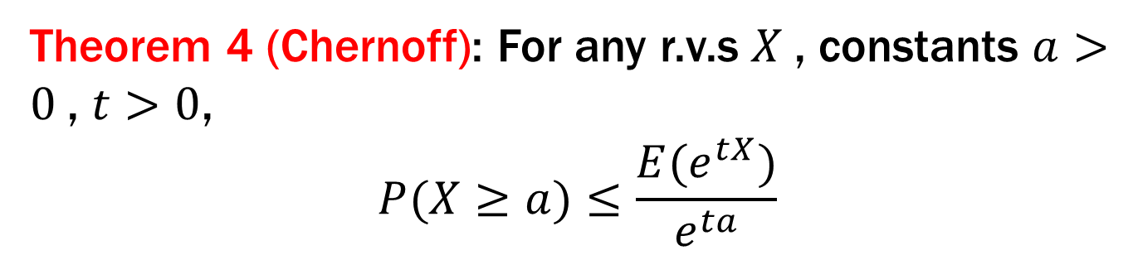
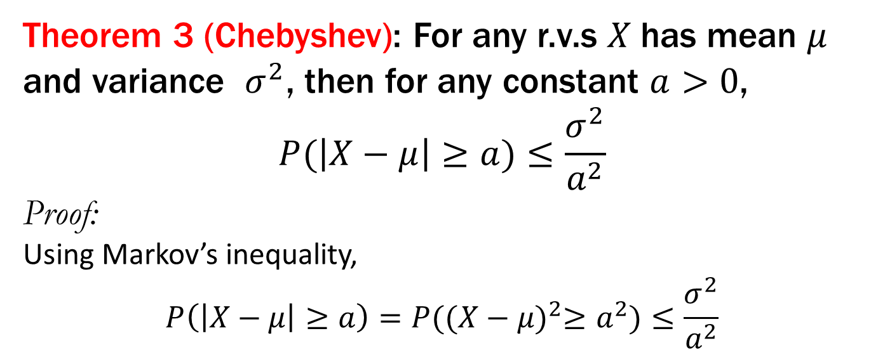
1 Inequalities
Theorem 3 (Chebyshev): For any r.v.s $X$has mean $μ$ and variance $σ^{2}$, then for any constant $a>0$,
$$P(\left|X−μ\right|≥a)≤\frac{σ^{2}}{a^{2}}$$
Proof:
Using Markov’s inequality,
$$P\left(\left|X−μ\right|≥a\right)=P({(X−μ)}^{2}≥a^{2})≤\frac{σ^{2}}{a^{2}}$$
Theorem 4 (Chernoff): For any r.v.s $X$, constants $a>0$, $t>0$,
$$P(X≥a)≤\frac{{E(e}^{tX})}{e^{ta}}$$

Slide 8
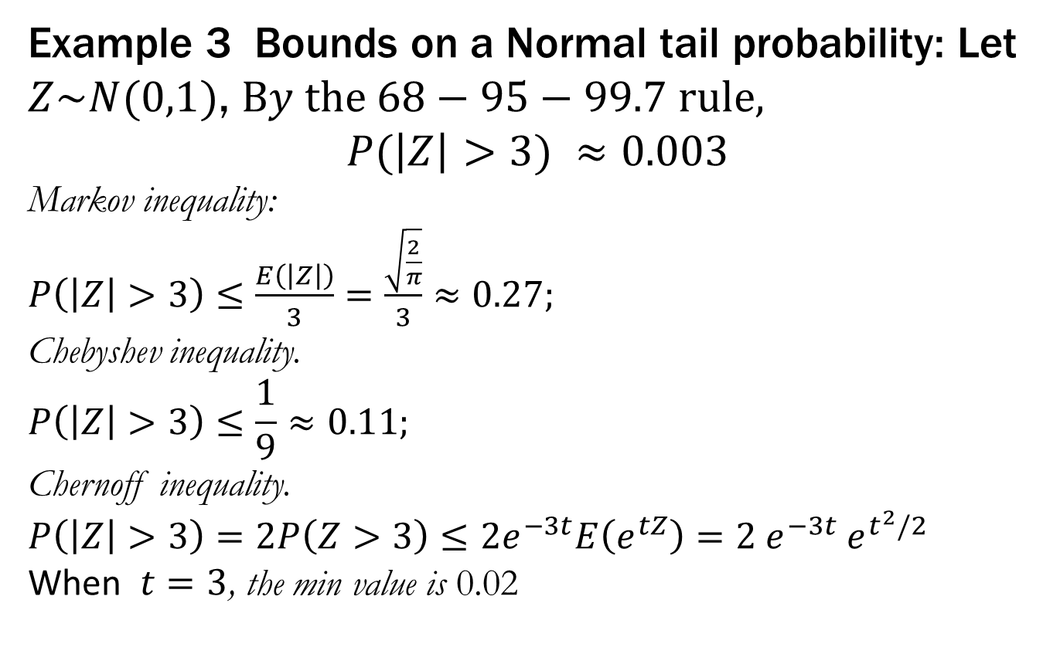
1 Inequalities
Example 3 Bounds on a Normal tail probability: Let $Z\sim N(0,1)$, $By the 68−95−99.7 rule,$
$$P(\left|Z\right|>3) ≈0.003$$
Markov inequality:
$P\left(\left|Z\right|>3\right)≤\frac{E\left(\left|Z\right|\right)}{3}=\frac{\sqrt{\frac{2}{π}}}{3}≈0.27;$
Chebyshev inequality.
$$P\left(\left|Z\right|>3\right)≤\frac{1}{9}≈0.11;$$
Chernoff inequality.
$P\left(\left|Z\right|>3\right)=2P\left(Z>3\right)≤2e^{−3t}E\left(e^{tZ}\right)=2 e^{−3t}$ $e^{t^{2}/2}$
When $t=3$, the min value is 0.02

Slide 9
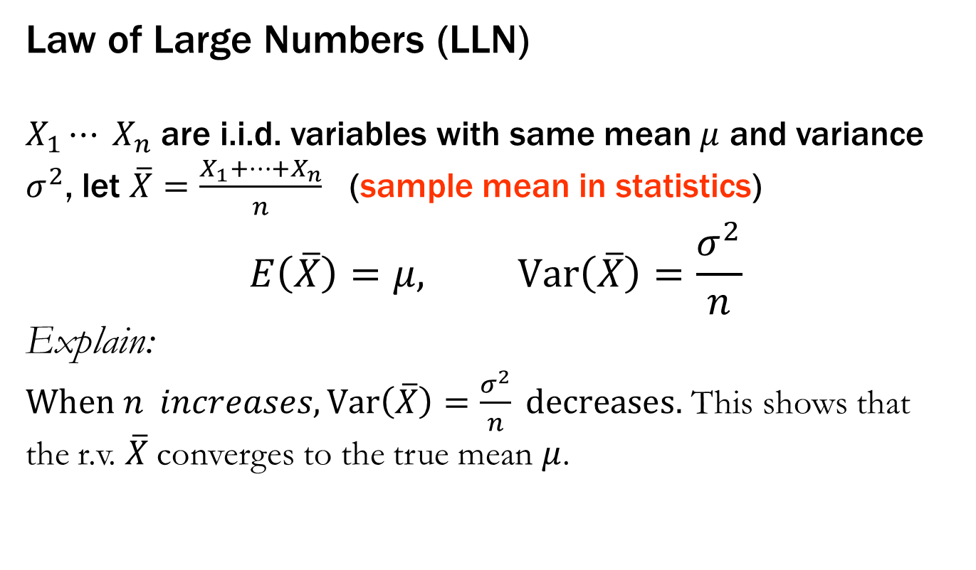
2 Central limit theorem
Law of Large Numbers (LLN)
$X_{1}⋯ X_{n}$are i.i.d. variables with same mean $μ$ and variance $σ^{2}$, let $\overline{X}=\frac{X_{1}+⋯+X_{n}}{n}$ (sample mean in statistics)
$$E\left(\overline{X}\right)=μ, Var\left(\overline{X}\right)=\frac{σ^{2}}{n}$$
Explain:
$When n increases,Var\left(\overline{X}\right)=\frac{σ^{2}}{n} decreases.$ This shows that
the r.v. $\overline{X}$converges to the true mean $μ$.

Slide 10
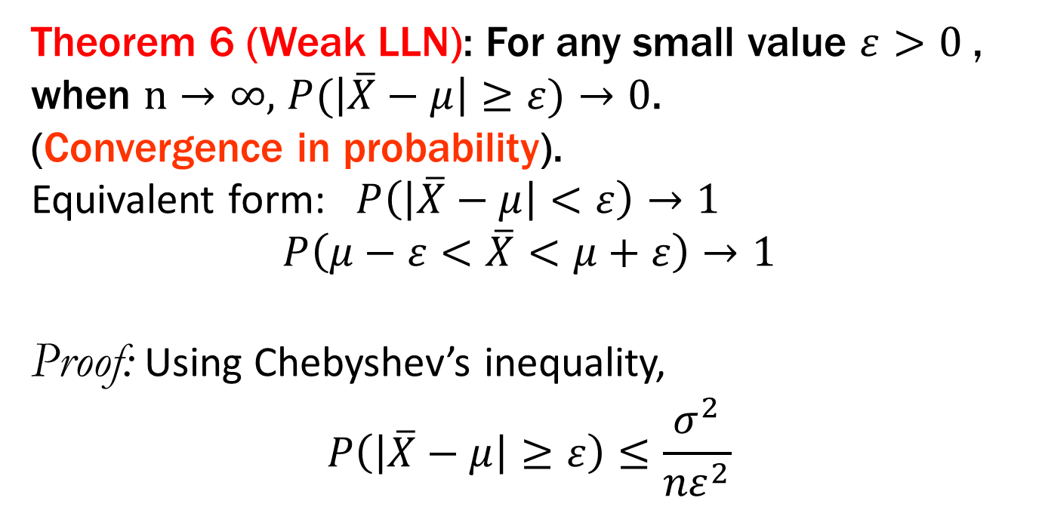
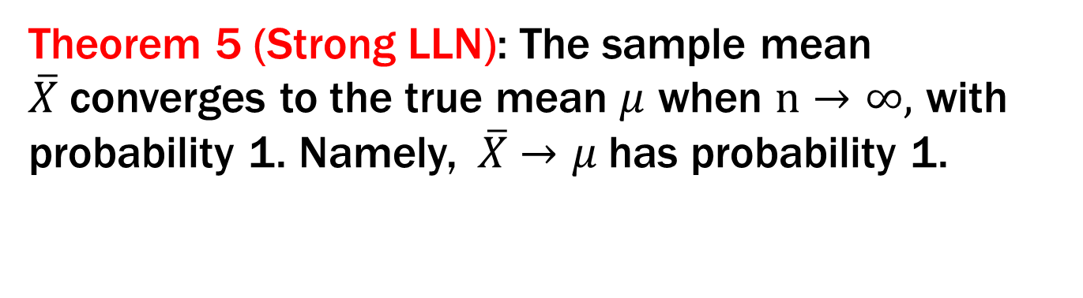
2 Central limit theorem
Theorem 5 (Strong LLN): The sample mean $\overline{X}$converges to the true mean $μ$ when $n→∞,$ with probability 1. Namely,$\overline{X}$ $→μ$has probability 1.
Theorem 6 (Weak LLN): For any small value $ε>0$, when $n→∞,$ $P(\left|\overline{X}−μ\right|≥ε)→0$.
(Convergence in probability).
Equivalent form: $P\left(\left|\overline{X}−μ\right|<ε\right)→1$
$$P\left(μ−ε<\overline{X}<μ+ε\right)→1$$
Proof: Using Chebyshev’s inequality,
$$P\left(\left|\overline{X}−μ\right|≥ε\right)≤\frac{σ^{2}}{{nε}^{2}}$$

Slide 11
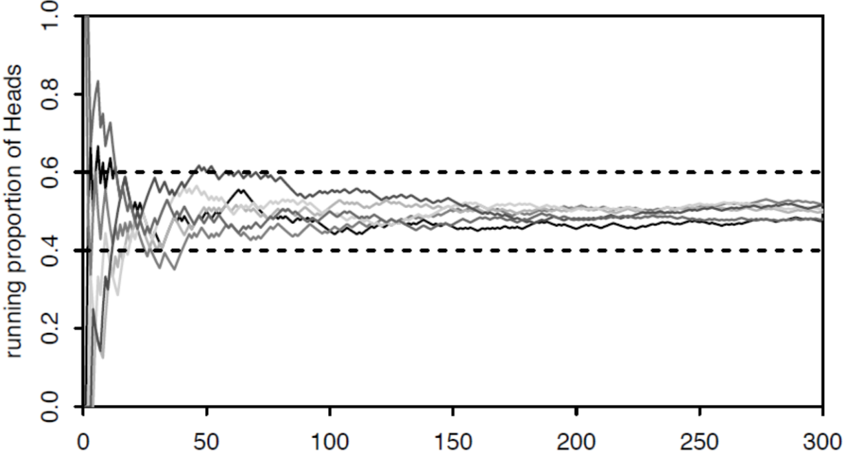
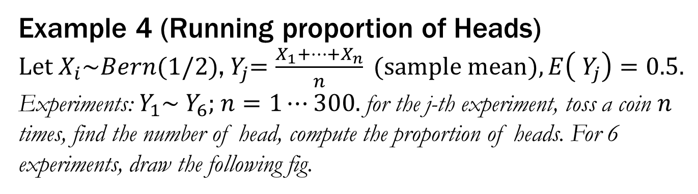
2 Central limit theorem
Example 4 (Running proportion of Heads)
$Let X_{i}\sim Bern(1/2)$,${ Y}_{j}=\frac{X_{1}+⋯+X_{n}}{n} (sample mean), E\left({ Y}_{j}\right)=0.5.$
Experiments:${ Y}_{1}\sim { Y}_{6};$ $n=1⋯300.$ for the j-th experiment, toss a coin $n$ times, find the number of head, compute the proportion of heads. For 6 experiments, draw the following fig.

Slide 12
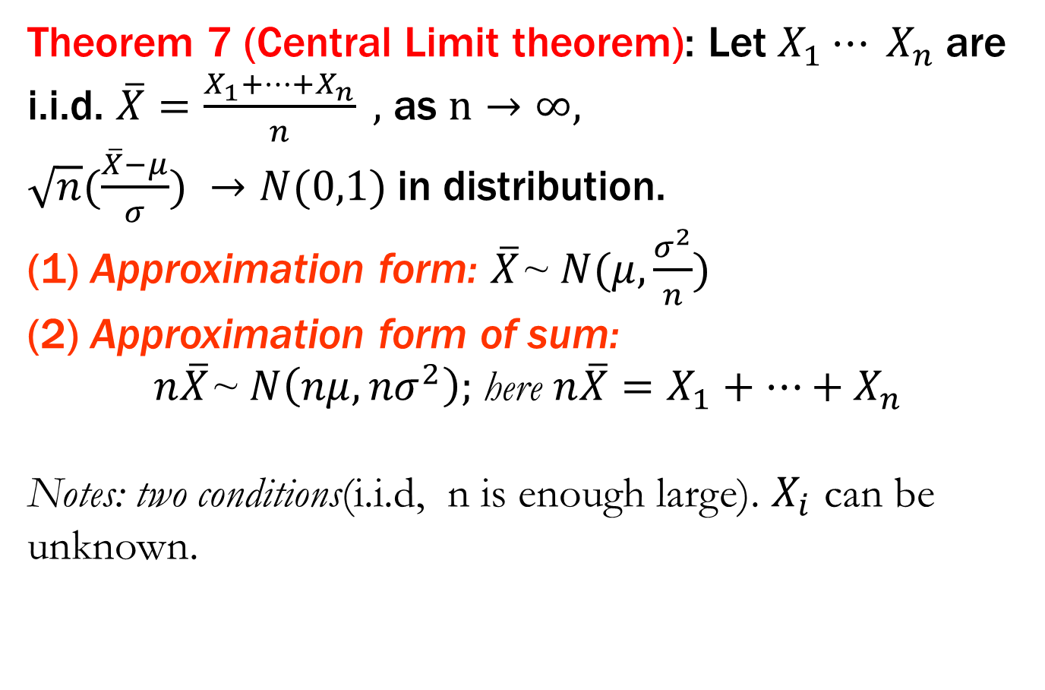
2 Central limit theorem
Theorem 7 (Central Limit theorem): Let $X_{1}⋯ X_{n}$are i.i.d. $\overline{X}=\frac{X_{1}+⋯+X_{n}}{n} ,$ as $n→∞,$
$\sqrt{n}(\frac{\overline{X}−μ}{σ}) →N(0,1)$in distribution.
(1) Approximation form: $\overline{X}$~ $N(μ,\frac{σ^{2}}{n})$
(2) Approximation form of sum:
$n\overline{X}$~ $N\left(nμ,{nσ}^{2}\right);$here $n\overline{X}=X_{1}+⋯+X_{n}$
Notes: two conditions(i.i.d, n is enough large). $X_{i}$ can be unknown.

Slide 13
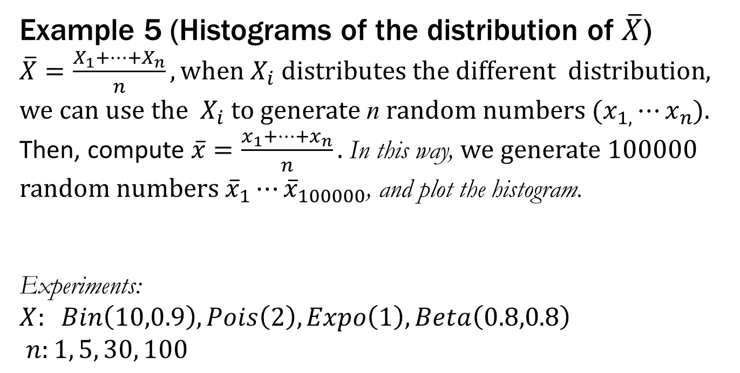
2 Central limit theorem
Example 5 (Histograms of the distribution of $\overline{X}$)
$\overline{X}=\frac{X_{1}+⋯+X_{n}}{n}, when{ X}_{i} distributes the different$ $distribution$, we can use the ${ X}_{i}$to generate n random numbers ($x_{1,}⋯x_{n}$).
Then, compute $\overline{x}=\frac{x_{1}+⋯+x_{n}}{n}.$ In this way, we generate 100000 random numbers ${\overline{x}}_{1}⋯{\overline{x}}_{100000}$, and plot the histogram.
Experiments:
$$X: Bin\left(10,0.9\right), Pois\left(2\right), Expo\left(1\right), Beta\left(0.8,0.8\right)$$
$n:1, 5, 30, 100$

Slide 14
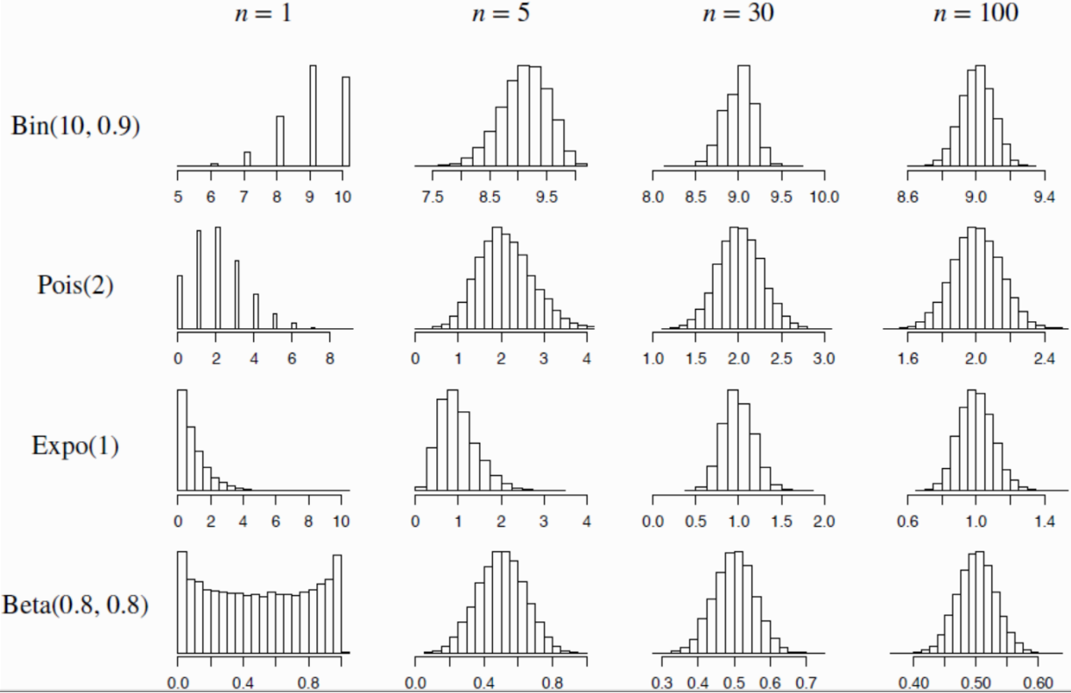
2 Central limit theorem
Example 5 (Histograms of the distribution of $\overline{X}$)

Slide 15
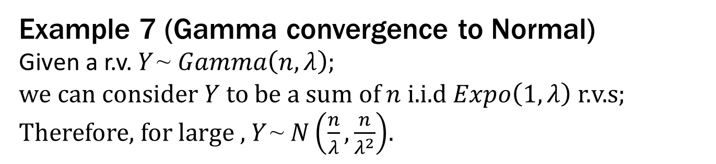
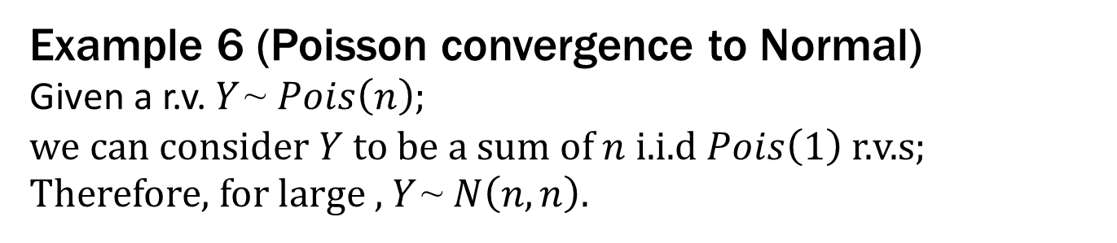
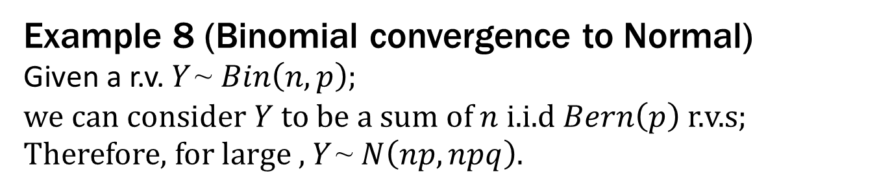
2 Central limit theorem
Example 6 (Poisson convergence to Normal)
Given a r.v. $Y$~ $Pois\left(n\right)$;
we can consider $Y$ to be a sum of $n$ i.i.d $Pois\left(1\right)$ r.v.s; Therefore, for large , $Y$~ $N\left(n, n\right)$.
Example 7 (Gamma convergence to Normal)
Given a r.v. $Y$~ $Gamma\left(n,λ\right)$;
we can consider $Y$ to be a sum of $n$ i.i.d $Expo\left(1,λ\right)$ r.v.s; Therefore, for large , $Y$~ $N\left(\frac{n}{λ}, \frac{n}{λ^{2}}\right)$.
Example 8 (Binomial convergence to Normal)
Given a r.v. $Y$~ $Bin\left(n,p\right)$;
we can consider $Y$ to be a sum of $n$ i.i.d $Bern\left(p\right)$ r.v.s; Therefore, for large , $Y$~ $N\left(np, npq\right)$.

Slide 16
2 Central limit theorem
Example 9 (Approximation of unknown distributions)
A.J. has 20 jobs that she must do in sequence, with the times
required to do each of these jobs being independent random
variables with mean 50 minutes and standard deviation 10 minutes. M.J. has 20 jobs that he must do in sequence, with the times required to do each of these jobs being independent random variables with mean 52 minutes and standard deviation 15 minutes.
a. Find the probability that A.J. finishes in less than 900 minutes.
b. Find the probability that M.J. finishes in less than 900 minutes.
c. Find the probability that A.J. finishes before M.J.

Slide 17
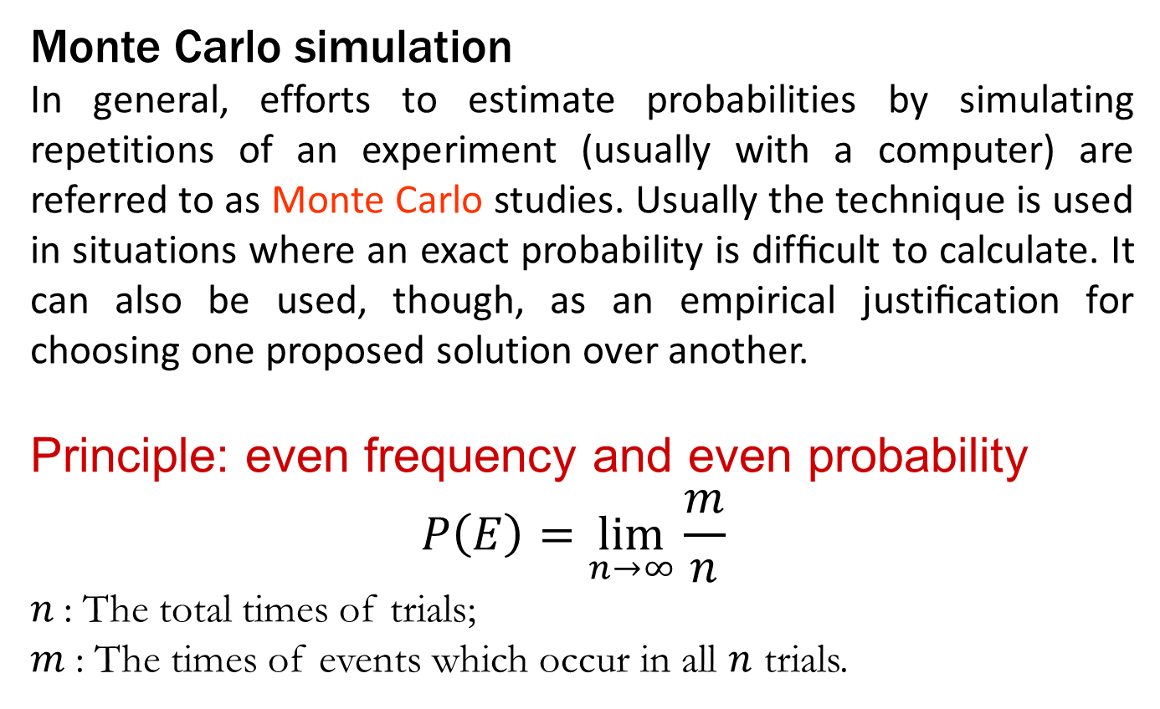
3 Monte Carlo simulation
Monte Carlo simulation
In general, efforts to estimate probabilities by simulating repetitions of an experiment (usually with a computer) are referred to as Monte Carlo studies. Usually the technique is used in situations where an exact probability is difﬁcult to calculate. It can also be used, though, as an empirical justiﬁcation for choosing one proposed solution over another.
Principle: even frequency and even probability
$$P\left(E\right)=\lim_{n→∞}{\frac{m}{n}}⁡$$
$n$: The total times of trials;
$m$: The times of events which occur in all $n$ trials.

Slide 18
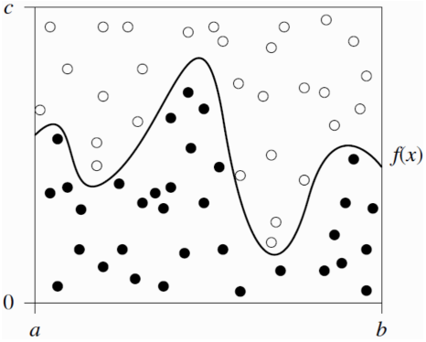
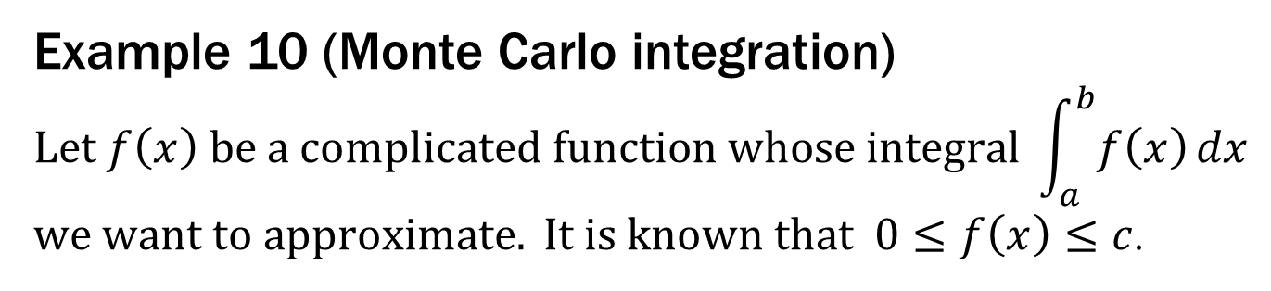
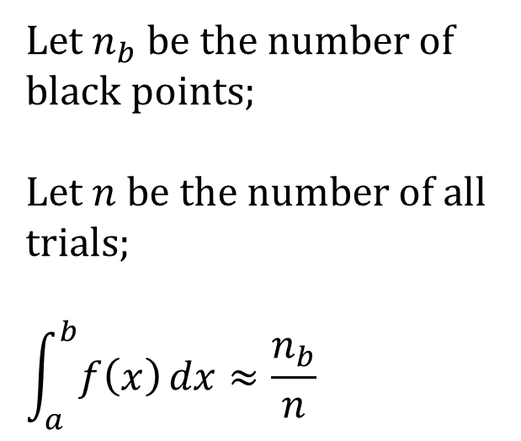
3 Monte Carlo simulation
Example 10 (Monte Carlo integration)
$$Let f\left(x\right) be a complicated function whose integral \int_{a}^{b}{f\left(x\right)}dx$$
$we want to approximate. It is known that 0≤f\left(x\right)≤c$.
$Let n_{b}$ be the number of black points;
$Let n$be the number of all trials;
$$\int_{a}^{b}{f\left(x\right)}dx≈\frac{n_{b}}{n}$$

